Slide 1
Theodore Roethke’s “My Papa’s Waltz”
Introduction to English Literature 04
May 14, 2025

Slide 2
Denotation and Connotation
Diction: the types of words, phrases, and sentence structures, and sometimes also of figurative language, that constitute any work of literature.
Denotation: the unambiguous or “dictionary” meaning of words.
Connotation: a suggestion of emotional coloration that imply our attitude and invite a similar one from our hearers.

Slide 3
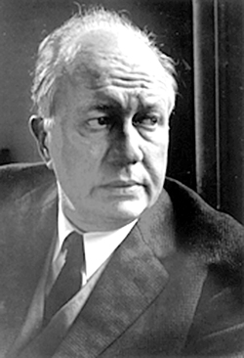
Theodore Roethke I
born on 25 May 1908, the only child of a large and successful commercial florist.
Trauma caused by his father’s death and his uncle’s suicide in 1922.
Graduate studies at Michigan and Harvard U after a year’s work at a law school.

Slide 4
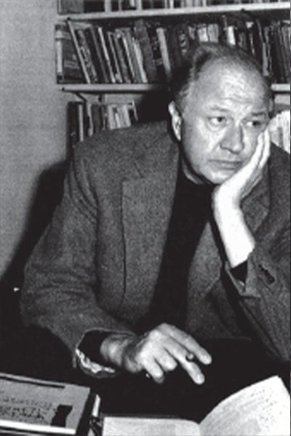
Theodore Roethke II
Teaching at many universities interrupted by his heavy drinking and mental disease.
Meeting Louise Bogan a poet having a brief affair with her.
The first collection of poems Open House(1941): “completely successful”(W.H. Auden), “a controlled grace of movement with images of utmost precision(Elizabeth Drew).”

Slide 5
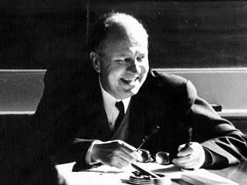
Theodore Roethke III
Meeting (and subsequent friendship) with Robert Lowell in 1947 providing a further impetus for the 'journey to the interior.’
The Lost Son and Other Poems (1948) announced the arrival of a major voice with poems of ‘greater intensity and symbolic depth.’
Praise to the End! (1951): his own version of a poet’s spiritual autobiography like Wordsworth’s The Prelude.
saw himself as participating in the lineage of 'mad' poets such as William Blake and John Clare

Slide 6
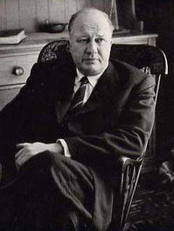
Theodore Roethke IV
Roethke's marriage to his former student Beatrice O’Connell.
Winning Pulitzer Prize with The Waking: Poems, 1933-1953 (1953) returning to the traditional prosody of his early verse while developing a new-found concern with sexual love.
Died unexpectedly with a heart attack in 1962.

Slide 7
My Papa’s Waltz I
The whiskey on your breath
Could make a small boy dizzy;
But I hung on like death:
Such waltzing was not easy.
당신의 숨에서 나는 위스키 냄새는
작은 소년을 어지럽게 할 정도였다.
하지만 나는 죽을 힘을 다해 (아빠에게) 매달렸다.
그런 왈츠 추기는 쉽지 않았다.

Slide 8
My Papa’s Waltz II
We romped until the pans
Slid from the kitchen shelf;
My mother’s countenance
Could not unfrown itself.
우리는 깡충깡충 뛰었다.
부엌 선반에서 프라이팬이 밀려 떨어질 때까지.
우리 엄마의 찡그린 얼굴이
펴질 날이 없었다.

Slide 9
My Papa’s Waltz III
The hand that held my wrist
Was battered on one knuckle;
At every step you missed
My right ear scraped a buckle.
내 손목을 붙들어 주던 그 손은
한 쪽 관절이 뭉개져 있었다.
당신이 한 스탭 틀릴 때마다
내 오른쪽 귀는 혁대 버클에 긁혔다.

Slide 10
My Papa’s Waltz IV
You beat time on my head
With a palm caked hard by dirt,
Then waltzed me off to bed
Still clinging to your shirt.
Poet’s own reading of “My Papa’s Waltz”: https://youtu.be/3yurYXtkbwU
당신은 내 머리 위에 박자를 맞췄다.
먼지가 묻어 딱딱하게 갈라진 손바닥으로.
당신의 셔츠를 악착같이 붙잡고 매달리는 나를
그렇게 왈츠를 추면서 침대로 데려가 내려놓았다.

Slide 11
“My Papa’s Waltz”: Odd Sentence Structure I
He does not say that the buckle scraped his ear, but rather “My right ear scraped a buckle.”
The speaker avoids placing blame and refuses to specify any unpleasant effect(480/826).

Slide 12
“My Papa’s Waltz”: Odd Sentence Structure II
In lines 5– 6, the connection between the romping and the pans falling is stated oddly: “We romped until the pans / Slid from the kitchen shelf”
The speaker does not say that they knocked down the pans or imply awkwardness, but he does suggest energetic activity and duration (480/826).

Slide 13
“My Papa’s Waltz”: Odd Sentence Structure III
“My mother’s countenance/ Could not unfrown itself.”
A silent bystander in this male ritual, she doesn’t seem frightened or angry. She seems to be holding a frown, or to have it molded on her face, as though it were part of her own ritual, and perhaps a facet of her stern character as well. The syntax implies that she has to maintain the frown, and the falling of the pans almost seems to be for her benefit. She disapproves, but she remains their audience (480/826).

Slide 14
Question I
Exactly how does the situation in “My Papa’s Waltz” and the poem itself fulfill or defy your expectations?
(479/825).
I expected a sentimental or nostalgic recollection of his father, but what he does recollect was a scene where he was waken up and forced into a bumpy round of waltz with his drunk father.

Slide 15
Question II
How does it characterize the waltz and the speaker’s feelings about it?
(479/825).
The dance was one-sidedly enforced by his father and not really pleasant at that time, but he did his best to follow the movement to go along with his father’s awkward but warm expression of his fatherly affection.

Slide 16
Question III
Which words are most suggestive in these terms?
(479/825).
“The hand that held my wrist/ Was battered on one knuckle;” because this implies that the narrator began to understand the tough life of his father’s by this even though he did not show it to his family.

Slide 17
Questions IV
What clues are there in the word choice that an adult is remembering a childhood experience? How scared was the boy at the time?
(479/825).
First 2 lines. Readers could imagine how much he was scared by wild movements in the expression such as “But I hung on like death”

Slide 18
Question V
How does the grown adult now evaluate the emotions he felt when he was a boy?
(479/825).
On the surface, the speaker, now an adult, tries to recollect the feelings that he thinks he had then as a child, but such an ‘objective’ reconstruction of his childhood experience evinces his belated understanding of his father’s affection that was then expressed only in an awkward manner.

